Slide 1
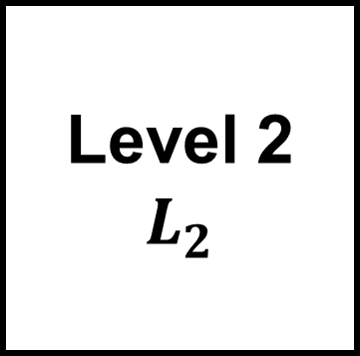


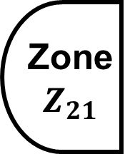







Building
B
Level 1
$$L_{1}$$
Level 2
$$L_{2}$$
HVAC
Room
$$H$$
Small
Room
$$SR_{1}$$
Big Room
$$BR_{1}$$
Small
Room
$$SR_{2}$$
Big Room
$$BR_{2}$$
Zone
$$Z_{11}$$
Zone
$$Z_{12}$$
Zone
$$Z_{21}$$
Zone
$$Z_{22}$$

Slide 2
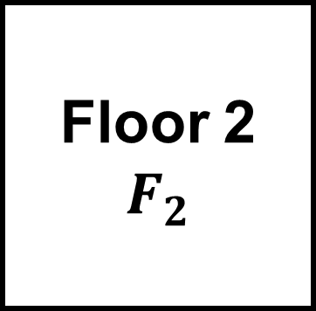
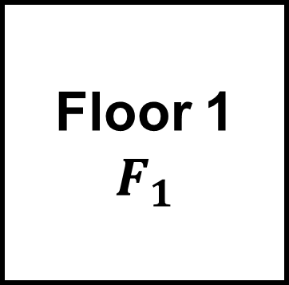
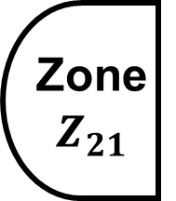




Building
B
Floor 1
$$F_{1}$$
HVAC
Room
$$H$$
Floor 2
$$F_{2}$$
Small
Room
$$SR_{1}$$
Big Room
$$BR_{1}$$
Big Room
$$BR_{2}$$
Small
Room
$$SR_{2}$$
Zone
$$Z_{11}$$
Zone
$$Z_{12}$$
Zone
$$Z_{21}$$
Zone
$$Z_{22}$$

Slide 3
SMART BUILDINGS
SENSING AT LOCATIONS
SENSING OF FACTORS
SENSOR MINIMIZATION MODEL
Objective Function
minimize the number of sensors
Constraint Functions
satisfying sensing requirement
sensing rules
sensing from sub-locations
available sensors
MINIMUM SENSOR DEPLOYMENT

